Slide 1
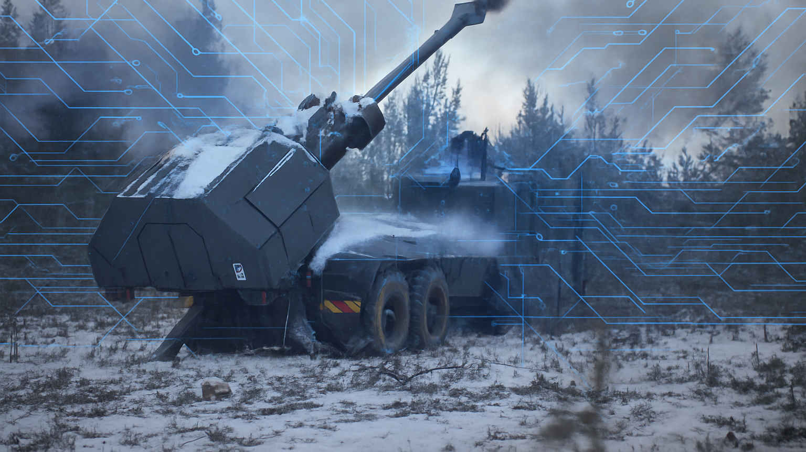


LEADERSHIP AND ARTIFICIAL INTELIGENCE
FACILITATOR NOTES
Recommended the Facilitator Prints out

Slide 2
AIM. To compliment the CAL’s annual Conference, these study packs are designed to stimulate discussion, broaden perspectives, capture key insights from the speakers and encourage participants to reflect on and challenge existing views.
4. WHO CAN DELIVER THIS?
Each exercise requires a facilitator; a member of the group who is capable and comfortable to do so, ideally with an instructional qualification.
2. WHO IS THIS DESIGNED FOR?
The study packs are designed to support group activity within messes. By including a range of ranks within each group, discussions are enriched with broader perspectives and varied experiences, encouraging deeper reflection and shared understanding.
3. WHEN TO USE THIS PACK?
The Packs are designed to be used as follow-up activity after the event. Allowing audiences to discuss elements raised from the conference.
5. HOW TO USE THIS PACK?
There are 5 exercises to choose from depending on what you think will be good for your audience.
We recommend spending 20-30 min on each exercise, to enable depth of understanding rather than cramming too much in.

Slide 3
Mini Ex2. The Digital Platoon Sergeant: A fictitious case Study based around an AI app that tracks soldiers' fitness , sleep and the dreaded guard list.
Leadership and Artificial intelligence Exercises.
Mini Ex1. AI in Action: A chance to experiment using AI looking at current withing your workspace that AI could improve/streamline.
In Depth Ex3. Op Iron Lantern: To understand how AI-generated information can lead to confident but opposing views, and to explore how leaders can make honest and ethical decisions when the facts are unclear or disputed.
Your role is to interpret incoming intelligence reports and provide a provisional 3-point plan to your HQ as to what to do next.
Mini Ex4. The Algorithm of War: A Case study looking at an AI-driven intelligence platforms that rapidly analyses data from intercepted communications, CCTV, satellite imagery, and social media to generate target packs. How can militaries balance the tactical advantage of speed against the ethical obligation to minimise civilian harm?
In Depth Ex5. AI and Leadership in Modern Conflict: A realistic modern war scenario, that looks at the ethical component of AI targeting and autonomous platforms. Teams will be placed under time pressure to make tactical and moral decisions. Comparing and discussing their leadership decisions.
In Depth Ex6. AI Debate: Should Artificial Intelligence be fully embraced and integrated into the military workplace and operational environments?

Slide 4



Facilitator Notes mini exercise 1 – AI in Action: Explore, Apply, Evaluate
Exercise summary
Step 1 (10 mins): Pick one real task or challenge SP are currently working on/will work on — e.g. designing a training schedule, consolidating meeting notes, generating ideas for a welfare initiative, etc.
Step 2 ( 20 mins): Choose an AI tool to tackle the chosen task. Experiment with different prompts, asking AI to refine, summarise, or expand its own outputs, etc. (Do not input any SECRET or OS work if using non MODNet AI tools).
Step 3 (15 minutes): Evaluate and reflect on the use of AI to tackle the task and share your observations with the group.
See handout for more details.
Objective: Using a live AI tool to explore how it can support for a real work challenge. Assess the output’s quality, limitations, and ethical implications.
Timings: 45 minutes
Resources: Handout 6. AI tools – ChatGPT, Copilot, Chat-MOD, Gemini, Poe, etc.

Slide 5
Facilitator Notes Exercise 2 - The Digital platoon sergeant
Exercise summary
Step 1 (2 mins): Introduce the topic.
Step 2 (5 mins): Separate into small group of 5-10.
Step 3 (20 mins): Encourage the groups to read through the scenario and as a group produce their conclusions to each of the discussion points.
Step 4 (15 mins): As the facilitator select different groups to voice their opinions on each discussion point. Compare to other groups opinions. Draw out key themes and similarities.
Objective: To create awareness of AI opportunities within barracks and to discuss issue that the integration of AI may bring.
Timings: Approx – 45 Min
Resources: Handout 2

Slide 6
Facilitator Notes – In Depth Ex 3 - Op Iron Lantern
Excise summary
Step 1 (30 mins): Read the context brief in handout 5. Split participants into two groups – Team A and Team B. Provide the respective teams with their allocated AI intelligence reports.
Step 2 (10 mins): Teams must provide answers to the questions at the bottom of the intelligence report. Their answers must be kept to themselves and not revealed to the other teams.
Step 3 (20 mins): Provide the teams with the second AI intelligence update. Teams must consider the follow-on questions at the bottom of the reports.
Step 4 (10 mins): Teams A and B must present their assessment and plans to the other team.
Step 5 (20 mins): Reveal the way in which AI was used to interpret the situation. Use the discussion prompts to reflect on the task/using AI in the military.
Objective: To understand how AI-generated information can lead to confident but opposing views, and to explore how leaders can make honest and ethical decisions when the facts are unclear or disputed.
Timings: Approx 1hr – 1.5hrs
Resources: Handout 5 – Op IRON LANTERN

Slide 7
Facilitator Notes – Mini Exercise 4 – The Algorithm of War.
Exercise
Step 1 (5 mins): Introduce the topic to participants. Read the scenario to the audience. Use the PP slides brief each action.
Step 2 (5 mins): Create groups ensuring that there is a mix of different ranks and cap badges. (if possible). No more than 10 SP per group.
Step 3 (20 mins): Allow each of the group's time to go through each of the discussion points. Allowing the groups to answer the 5 discussion points.
Step 4 (20 min): Ensure each group has nominated speakers. Allow each group in tern to voice their groups opinions to the remaining groups. Bounce from each group to get broader perceptions and generate discussion.
Step 5 (5 min): Wrap up with a summary of common themes and alternate perceptions.
Objective: A Case study looking at an AI-driven intelligence platforms used for targeting. Does using AI risk eroding human judgment ?
Timings: Approx 1hr – 1.5hrs (45-60 mins for the debate).
Resources: Handout The Algorithm of War. A flip chart or whiteboard per group may be required.

Slide 8
Facilitator Notes –In Depth Exercise 5 - AI and Leadership in Modern Conflict
Exercise
Step 1 (5 mins): Introduce the topic to participants. Read the scenario to the audience. Explain this activity is designed to put groups under time pressure to make decisions.
Step 2 (10 mins): Create groups ensuring that there is a mix of different ranks and cap badges. (if possible). No more than 10 SP per group.
Step 3 (40 mins): Facilitator is to read out each Inject and start the timer 5 Min. Encourage each group to discuss the issues and as a collective, agree on each decision point. Ensuring they are captured. Facilitator must move onto the next inject after the allotted time. To ensure pressure is maintained.
Step 4 (20-30 mins): Wrap up. Go through each inject .Encourage each group to explain their Decision points and compare to other groups. Use Sheet 2 to draw out key points and discuss issues and similarities raised.
Objective: Raise awareness of the integration of AI in modern conflict. Looking at decision made by leaders under time constraints.
Timings: Approx 1hr – 1.5hrs (45-60 mins for the debate).
Resources: Handout AI and Leadership in Modern Conflict. A flip chart or whiteboard per group may be required.

Slide 9
Facilitator Notes – AI and Leadership in Modern Conflict
Setup (2 minutes)
Briefly introduce the scenario: British Army battlegroup in 2028, urban conflict, AI-enabled systems.
Emphasise the purpose: exploring leadership under pressure when AI is influencing decisions.
Inject 1: The Apartment Block (3 minutes)
Decision Point: Approve strike, delay/deny, or seek alternatives.
Facilitator Prompts:
What factors drive your choice — mission success, civilian risk, or values?
Who holds responsibility if civilians are harmed: the AI, the commander, or higher command?
How would you justify this decision to soldiers and the media afterwards?
Teaching Point: Leadership accountability cannot be outsourced to AI.
Inject 2: The Drone Swarm (3 minutes)
Decision Point: Approve full autonomy, maintain semi-control, or abort.
Facilitator Prompts:
What risks are you willing to accept: losing control to AI or risking mission failure?
How does tempo (speed of battle) affect ethical decision-making?
What would soldiers expect from their leaders here?
Teaching Point: Leadership is about balancing risk, values, and accountability — even when tech outpaces human reaction.
Inject 3: Propaganda and Morale (3 minutes)
Decision Point: Ignore propaganda, actively brief soldiers, or distance from AI decisions.
Facilitator Prompts:
How do you sustain trust and morale in your unit when the fight is also online?
What is the role of openness and communication in leadership here?
What happens if leaders “blame the machine” — how does this affect trust?
Teaching Point: Trust is maintained through communication, ownership, and presence.

Slide 10
Facilitator Notes – AI and Leadership in Modern Conflict Sheet 2
Wrap-Up Discussion (5 minutes)
Compare group decisions:
Were choices consistent across groups, or did they diverge? Why?
What values or instincts shaped those decisions?
Leadership Points to Draw Out:
Accountability: Leaders must own outcomes of AI-influenced decisions — responsibility cannot be delegated to technology.
Moral Courage: Sometimes the “slower” or riskier path may be the right one if it aligns with values and protects civilians.
Trust: Soldiers need to trust both the technology and their leaders. How do leaders earn and keep that trust?
Communication: Clear, honest communication is vital to maintain morale in the face of propaganda and doubt.
Judgement Under Uncertainty: AI may provide probabilities, not certainties. Leadership is about deciding when information is incomplete or ambiguous.
Tempo vs. Values: Leaders must balance the pressure for rapid action with the obligation to uphold ethics and the Laws of Armed Conflict.
Human Element: AI can provide data and speed, but leaders provide context, empathy, and moral guidance — things a machine cannot replicate.
Future Skills: Leaders will need digital literacy, ethical reasoning, and the ability to integrate AI tools without losing the “human touch.”
Concluding line for facilitator:
“AI won’t replace leadership — it will redefine it. The challenge for future leaders is to harness its strengths without surrendering the core

Slide 11
Facilitator Notes In-depth Exercise 6 Overview – DEBATE
Exercise summary
Step 1 (5 mins): Introduce debate topic to participants. Decide who will debate and who will spectate.
Step 2 (10 mins): Split room into those who believe AI should be embraced and adopted into our working lives, and those who believe it shouldn’t. If there is an unequal number for the 'for' and 'against' argument, assign individuals to a side which they must argue for (even if they disagree with the motion).
Step 3 (45 mins): Groups split off and prepare their debate. They should prepare an introduction, 3 rounds of arguments and a conclusion. The number of arguments can be amended according to number of participants. You may wish to print off the debate structure as a handout
Step 4 (45 – 60 mins): Debate commences. Facilitator can chair the debate or choose a chair.
Objective: Debating fosters critical thinking, persuasive communication, and the ability to analyse complex topics from multiple perspectives.
Timings: Approx 1hr – 1.5hrs (45-60 mins for the debate).
Resources: Handout 4 – debate motion and structure guide.

Slide 12
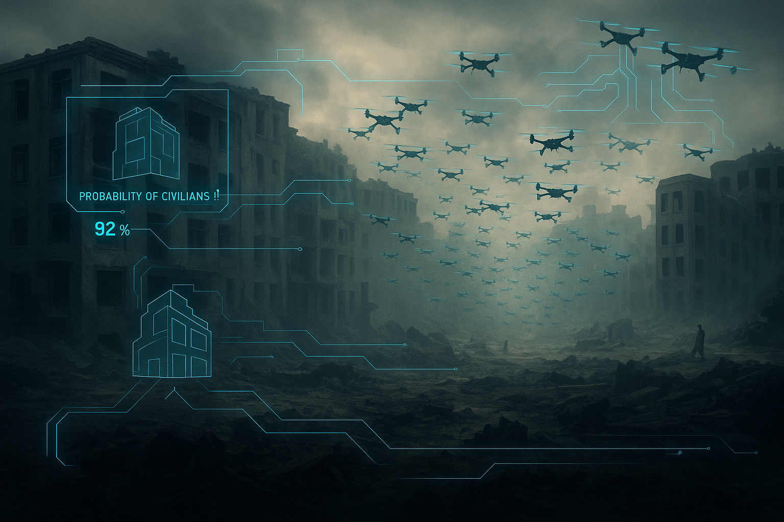

Facilitator Notes In Depth Ex 6 Debate: AI
Exercise summary
Step 1 (5 mins): Introduce debate topic to participants. Decide who will debate and who will spectate.
Step 2 (10 mins): Split room into those who believe AI should be embraced and adopted into our working lives, and those who believe it shouldn’t. If there is an unequal number for the 'for' and 'against' argument, assign individuals to a side which they must argue for (even if they disagree with the motion).
Step 3 (45 mins): Groups split off and prepare their debate. They should prepare an introduction, 3 rounds of arguments and a conclusion. The number of arguments can be amended according to number of participants.
Step 4 (45 – 60 mins): Debate commences. Facilitator can chair the debate or choose a chair.
Objective: Debating fosters critical thinking, persuasive communication, and the ability to analyse complex topics from multiple perspectives.
Timings: Approx 1hr – 1.5hrs (45-60 mins for the debate).
Resources: Handout 4 – debate motion and structure guide.

