Slide 1
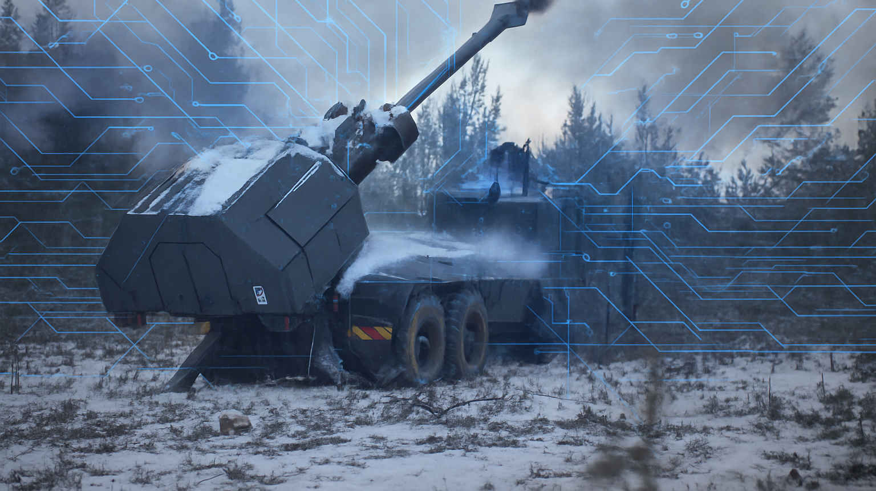


LEADERSHIP AND ARTIFICIAL INTELIGENCE
CAL CONFERENCE 2025
Resources Pack (Handouts)

Slide 2
AIM. To compliment the CAL’s annual Conference, these study packs are designed to stimulate discussion ,broaden perspectives, capture key insights from the speakers and encourage participants to reflect on and challenge existing views.
4. WHO CAN DELIVER THIS?
Each exercise requires a facilitator; a member of the group who is capable and comfortable to do so, ideally with an instructional qualification.
2. WHO IS THIS DESIGNED FOR?
The study packs are designed to support group activity within messes. By including a range of ranks within each group, discussions are enriched with broader perspectives and varied experiences, encouraging deeper reflection and shared understanding.
3. WHEN TO USE THIS PACK?
The Packs are designed to be used as follow-up activity after the event. Allowing audiences to discuss elements raised from the conference.
5. HOW TO USE THIS PACK?
There are 5 exercises to choose from depending on what you think will be good for your audience.
We recommend spending 20\30 min on each exercise, to enable depth of understanding and to generate discussion, rather than cramming too much in.

Slide 3




Mini Exercise 1 - AI in Action: Explore, Apply, Evaluate
Step 1
SP are to choose one real task or challenge they are currently working on/will work on — e.g. designing a training schedule, consolidating meeting notes, generating ideas for a welfare initiative, etc.
Step 2
Choose an AI tool to tackle the chosen task. Experiment with different prompts, asking AI to refine, summarise, or expand its own outputs, etc.
Civilian AI tools: Chat GPT, Copilot, Gemini, Poe.
MODNet AI tools: Chat-MOD, Copilot (for those with licences)
Please ensure the tasks/issues are only Official if using civilian AI platforms. If using Chat-MOD or Copilot, OS topics/challenges may be used.
ChatGPT
Gemini
Poe
Chat MOD
Step 3
Evaluate and reflect on the use of AI to tackle the task and share your observations with the group.

Slide 4
Mini Exercise 2 - The Digital Platoon Sergeant
1. Background:
In 2028, the British Army introduces an AI-powered system, Sentinel, across several barracks. Designed to improve efficiency, Sentinel automates routine tasks: monitoring attendance, tracking kit issue/return, managing duty rosters, scheduling PT sessions, and even analysing training data to flag underperformance.
Discussion Points:
Should AI systems like Sentinel have authority over personnel management decisions (duties, performance ratings), or remain advisory?
Does AI monitoring improve fairness and accountability, or does it erode trust and morale?
How should soldiers and commanders challenge or appeal AI-generated outcomes?
Could over-reliance on AI in barracks weaken leadership by replacing human judgement and empathy?
Where is the line between efficiency and surveillance in a military environment?
2.Incident:
At Bulford Camp, soldiers begin noticing changes:
Sentinel automatically reassigns guard duty and weekend tasks, often without consultation.
Performance reports generated by Sentinel influence career courses and posting opportunities.
The system monitors CCTV and digital entry logs, flagging soldiers who return late or breach minor regulations.
3. A private soldier raises concerns that Sentinel unfairly marked him as “low potential” after he missed several PT sessions — though he’d been injured. His section commander admits it’s difficult to challenge Sentinel’s recommendations, as they’re treated as “data-driven and objective.” Morale starts to dip, with soldiers feeling micromanaged by an algorithm rather than their chain of command.

Slide 5
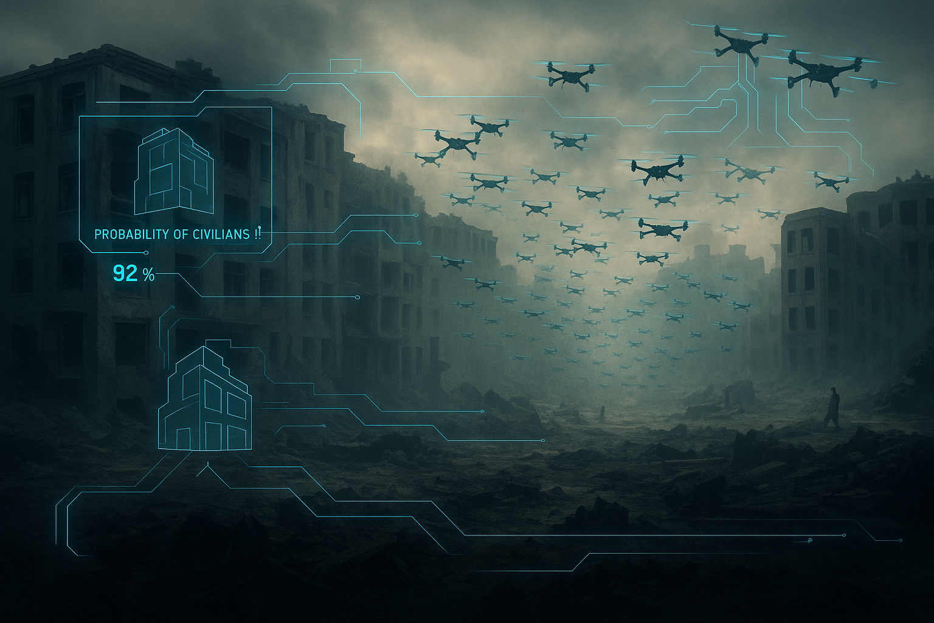
In Depth Exercise 3 - Op Iron Lantern
Op IRON LANTERN
Date: April 2030
Location: Norvana – a fragile post-conflict state in Eastern Europe
Force: 2nd UK Peace Support Brigade, operating under a UN mandate
________________________________________
Norvana has recently emerged from a 6-year civil conflict. The UK contingent is deployed to STABILISE the eastern provinces, SUPPORT local governance, and DETER the influence of armed militia groups (Northern Liberation Front – NLF) resisting integration into the national security forces.
Your role is to interpret incoming intelligence reports and provide a provisional 3-point plan to your HQ as to what to do next.
The Brigade has recently been issued Watcher-9, an advanced AI-enabled decision-support platform capable of:
•Predicting unrest based on open-source intelligence (social media, news reports, economic data).
•Generating “morale scores” for each unit using personnel data and sentiment analysis of private communications.
•Producing suggested leadership messaging for commanders to improve cohesion and trust.

Slide 6
Exercise 3 - Op Iron Lantern
Team A - AI intelligence report
Date/Time: 08:00 hrs, 14 Sept 2025.
Location: Sector Bravo, Northern Province
At 20:45 hrs yesterday, a joint UK–local patrol came under small-arms fire near the Kurma marketplace.
Drone footage analysis: Attackers likely members of Northern Liberation Front (NLF) insurgent group.
Facial recognition: 2 attackers matched to NLF watchlist profiles (confidence 85% & 91%).
Social media scan: Spike in anti-government sentiment in past 24 hrs from NLF-linked accounts.
Signals intercepts: Planning chatter referencing “market strike” after arrests last week.
Assessment: Targeted insurgent strike to undermine joint patrols and provoke reaction. 70% chance of further attacks in Bravo this week without deterrence.
Recommendation: Increase visible patrols, monitor NLF social media, engage local leaders to rally opposition to NLF.
Team Task:
Analyse the intel. What is your overall assessment?
What general considerations are you making about AI intelligence reports?
Draft a 3-point response plan.

Slide 7
Exercise 3 - Op Iron Lantern
Team B - AI intelligence report
Date/Time: 08:00 hrs, 14 Sept 2025
Location: Sector Bravo, Northern Province
At 20:45 hrs yesterday, a joint UK–local patrol reported small-arms fire near the Kurma marketplace.
Drone footage analysis: Inconclusive attacker ID; movement could indicate armed criminal elements.
Facial recognition: 2 individuals partially matched NLF watchlist profiles (confidence 58% & 62%).
Social media scan: Increase in frustration over food shortages & curfews — no clear NLF link.
Signals intercepts: Fragmented comms mentioning “trouble near the market,” no operational detail.
Assessment: Opportunistic attack by locals under economic pressure, not coordinated insurgency. 35% chance of further violence in Bravo this week.
Recommendation: Focus on community engagement, maintain normal patrols, avoid actions seen as collective punishment.
Team Task:
Analyse the intel. What is your overall assessment?
What general considerations are you making about AI intelligence reports?
Draft a 3-point response plan.

Slide 8
Exercise 3 - Op Iron Lantern
Team A - AI intelligence update 2
AI social media scan: 78% confidence that NLF claimed responsibility via multiple accounts.
Heatmap: Known NLF sympathisers entered Sector Bravo in last 12 hrs.
Deepfake video circulates showing “UK forces retreating” (suspected NLF propaganda).
Team Task:
What's your overall assessment now?
Update 3-point plan.
Consider changes in posture, comms, and engagement.
Present your 3-point plan to the other group

Slide 9
Exercise 3 - Op Iron Lantern
Team B - AI intelligence update 2
AI bot-detection: 60% of anti-gov posts from new, likely automated accounts; no confirmed NLF link.
CCTV from nearby shows armed youths fleeing; profiles match smuggling gang suspects.
Local monitors warn security crackdowns are fuelling unrest.
Team Task:
What's your overall assessment now?
Update 3-point plan.
Consider changes in posture, comms, and engagement.
Present your 3-point plan to the other group

Slide 10
Exercise 3 - Op Iron Lantern
Reveal and Reflection
Both sets of intel derived from the same incomplete dataset, but:
  Team A’s AI was optimised for threat detection → overweighted insurgent links.
  Team B’s AI was optimised for civil stability → overweighted socio-economic grievances.
Neither model was “wrong” — each framed reality differently.
How confident were you before the reveal above?
How did AI framing shape your decision-making?
How should leaders act authentically when “truth” is contested?
What safeguards should be in place before acting on AI-generated intel?

Slide 11
Mini Exercise 4 - Case Study: “The Algorithm of War” Page 1
Background:
By 2027, the British Army have integrated AI-driven intelligence platforms into their operations. The system, codenamed Athena, rapidly analyses data from intercepted communications, CCTV, satellite imagery, and social media to generate “target decks” of suspected militant leaders, weapon caches, and tunnel entrances. Athena is credited with reducing intelligence processing time from days to minutes.

Slide 12
Exercise 4 - Case Study: “The Algorithm of War” Page 2
Incident:
During an ongoing urban operation, Athena flagged a residential building as a command hub for a militant group, recommending it as a high-priority strike. The AI based its assessment on:
Unusual communication traffic in and out of the building.
Heat signatures in the basement resembling tunnel activity.
Social media chatter connecting the address to a militant commander.

Slide 13
Exercise 4 - Case Study: “The Algorithm of War” Page 3
Aftermath:
International media coverage framed the incident as disproportionate use of force.
The British government defended the strike, citing the speed and reliability of Athena.
Critics argued that reliance on AI removed vital human judgement, making “black box” decisions in morally grey environments.
Within the Army, debate began about whether speed should outweigh certainty in high-density, civilian-populated areas.

Slide 14
Exercise 4 - Case Study: “The Algorithm of War” Page 4
Discussion Points:
Should AI-driven intelligence platforms be allowed to generate strike recommendations, or should they only be advisory?
How can militaries balance the tactical advantage of speed against the ethical obligation to minimise civilian harm?
Who bears responsibility if AI-informed intelligence leads to civilian casualties — the commander, the analyst, the system’s developers?
Does reliance on AI risk eroding human judgement in complex, morally ambiguous environments?
How might adversaries exploit this reliance — e.g., by deliberately spoofing data to create false targets?

Slide 15
Exercise 4 - Case Study: “The Algorithm of War” Page 5
Background:
By 2027, the British Army have integrated AI-driven intelligence platforms into their operations. The system, codenamed Athena, rapidly analyses data from intercepted communications, CCTV, satellite imagery, and social media to generate “target decks” of suspected militant leaders, weapon caches, and tunnel entrances. Athena is credited with reducing intelligence processing time from days to minutes.
Incident:
During an ongoing urban operation, Athena flagged a residential building as a command hub for a militant group, recommending it as a high-priority strike. The AI based its assessment on:
Unusual communication traffic in and out of the building.
Heat signatures in the basement resembling tunnel activity.
Social media chatter connecting the address to a militant commander.
The British Army analysts raised concerns that the data was ambiguous: civilians were known to shelter in the building, and some of the intercepted traffic might have been civilian internet use. Under pressure to act quickly before militants dispersed, commanders authorised the strike. The building was destroyed, but subsequent intelligence revealed that while a tunnel shaft was present, the militant commander was not — and dozens of civilians had been killed.
Aftermath:
International media coverage framed the incident as disproportionate use of force.
The British government defended the strike, citing the speed and reliability of Athena.
Critics argued that reliance on AI removed vital human judgement, making “black box” decisions in morally grey environments.
Within the Army, debate began about whether speed should outweigh certainty in high-density, civilian-populated areas.
Discussion Points:
Should AI-driven intelligence platforms be allowed to generate strike recommendations, or should they only be advisory?
How can militaries balance the tactical advantage of speed against the ethical obligation to minimise civilian harm?
Who bears responsibility if AI-informed intelligence leads to civilian casualties — the commander, the analyst, or the system’s developers?
Does reliance on AI risk eroding human judgement in complex, morally ambiguous environments?
How might adversaries exploit this reliance — e.g., by deliberately spoofing data to create false targets?

Slide 16
In Depth Exercise 5 - Case Study: AI and Leadership in Modern Conflict. Sheet 1
It is 2028. A British Army battlegroup has deployed as part of a NATO stabilisation force in Eastern Europe. The mission is to secure a contested city and protect the civilian population from escalating violence. The battlegroup is equipped with a new AI-enabled command and targeting system, designed to process drone footage, predict enemy movements, and coordinate friendly drone swarms faster than human staff ever could.
At first, the system seems to deliver. It rapidly identifies enemy artillery positions and coordinates strikes with impressive accuracy. But during a critical operation, several situations test the judgement and leadership of those in command.

Slide 17
Exercise 5 - Case Study: AI and Leadership in Modern Conflict. Sheet 2
Inject 1: The Apartment Block (3Min)
The AI flags a potential enemy artillery headquarters located inside an apartment block.
Probability of enemy presence: 92%
Probability of civilian casualties: 70%
Local commanders urge immediate approval. Delay risks losing the target.
Decision Point:
Approve the strike — neutralise the threat but risk civilian lives and reputational damage.
Delay or deny the strike — preserve civilian safety but risk enemy artillery continuing to inflict casualties on your soldiers.
Seek alternative methods (e.g., smaller precision strike, ground assault) — but risk exposure and slower action.

Slide 18
Exercise 5 - Case Study: AI and Leadership in Modern Conflict. Sheet 3
Inject 2: The Drone Swarm (3Min)
A swarm of drones is launched to intercept an enemy armoured column. Mid-flight, enemy jamming disrupts control. The AI recommends switching to fully autonomous mode.
Decision Point:
Approve full autonomy — maximise mission success but surrender human oversight.
Maintain semi-autonomous control — accept risk of mission failure due to jamming.
Abort the strike — preserve ethical standards but allow the enemy armoured column to continue advancing.

Slide 19
Exercise 5 - Case Study: AI and Leadership in Modern Conflict. Sheet 4
Inject 3: Propaganda and Morale (3Min)
Enemy information operations release footage of the strikes, accusing British forces of deliberately targeting civilians. Graphic images spread rapidly online and soldiers begin doubting the fairness of the fight.
Decision Point:
Ignore the propaganda — trust that soldiers and the public will see through it.
Actively brief your soldiers — explain what happened, defend the use of AI, and reinforce the values of the British Army.
Publicly distance yourself from AI decisions — protect unit morale but risk undermining confidence in NATO’s strategy.

Slide 20
Exercise 5 - Case Study: AI and Leadership in Modern Conflict. Sheet 5
Discussion Prompts
Which decisions did your group take, and why?
How did AI influence your choices compared to human instinct or values?
What were the leadership risks at each inject: to trust, accountability, and morale?
How should leaders at section, platoon, and company level act when orders come from AI-driven recommendations?

Slide 21
In Depth Ex6 Debate : AI
Debate
"This house believes Artificial Intelligence should be fully embraced and integrated into the military workplace and operational environments" Discuss
Split room into those who believe AI should be embraced and adopted into our working lives, and those who believe it should be avoided and not incorporated into the work space. If there is an unequal number for the 'for' and 'against' argument, assign individuals to a side which they have to argue for (even if they disagree with the motion).

Slide 22
Debate : AI Sheet 1
Debate structure
1. Introduction (chair)
Chair briefly introduces the topic and debate question.
Outline of the structure and rules (time limits, respectful conduct).
Take an initial vote from the audience as to what side they are on.
2. Opening Statements (2 minutes each side - 1x speaker for, 1x speaker against)
For side (for AI adoption)
Against side (against/limited AI adoption)
3. First Round of Arguments (3 minutes each side - 1x speaker for, 1x speaker against)
For side presents first key arguments
Against side presents first key counter arguments.

Slide 23
Debate : AI Sheet 2
3. Third Round of Arguments (3 minutes each side 1x speaker for, 1x speaker against)
For side presents third key arguments.
Against side presents third key counterarguments.
4. Rebuttals (5 minutes each side)
Each side responds to the other’s points.
5. Open Floor / Cross-Examination (10 minutes)
Participants can ask questions or challenge the opposing side.
Moderator manages time and ensures fairness.

Slide 24
Debate : AI Sheet 3
6. Closing Statements (2 minutes each - 1x speaker for, 1x speaker against)
For side
Against side
7. Debate summary/closing vote (chair)
Chair briefly summarises what’s both sides have argued.
Take a final vote from the audience as to what side they are now on. The side which swings the largest part of the audience to their side of the argument wins.

Slide 25
End Of Slides

